Slide 1
PADU Concepts Business & Technology
Vikas Anand

Slide 2
What is PADU
P - Preferred
A - Acceptable
D - Discouraged
U - Unacceptable

Slide 3
Building Blocks
Architecture Building Blocks
Solution Building Blocks

Slide 4
Architecture Building Blocks
B: Business
D: Data
A: Application
T: Technology

Slide 5
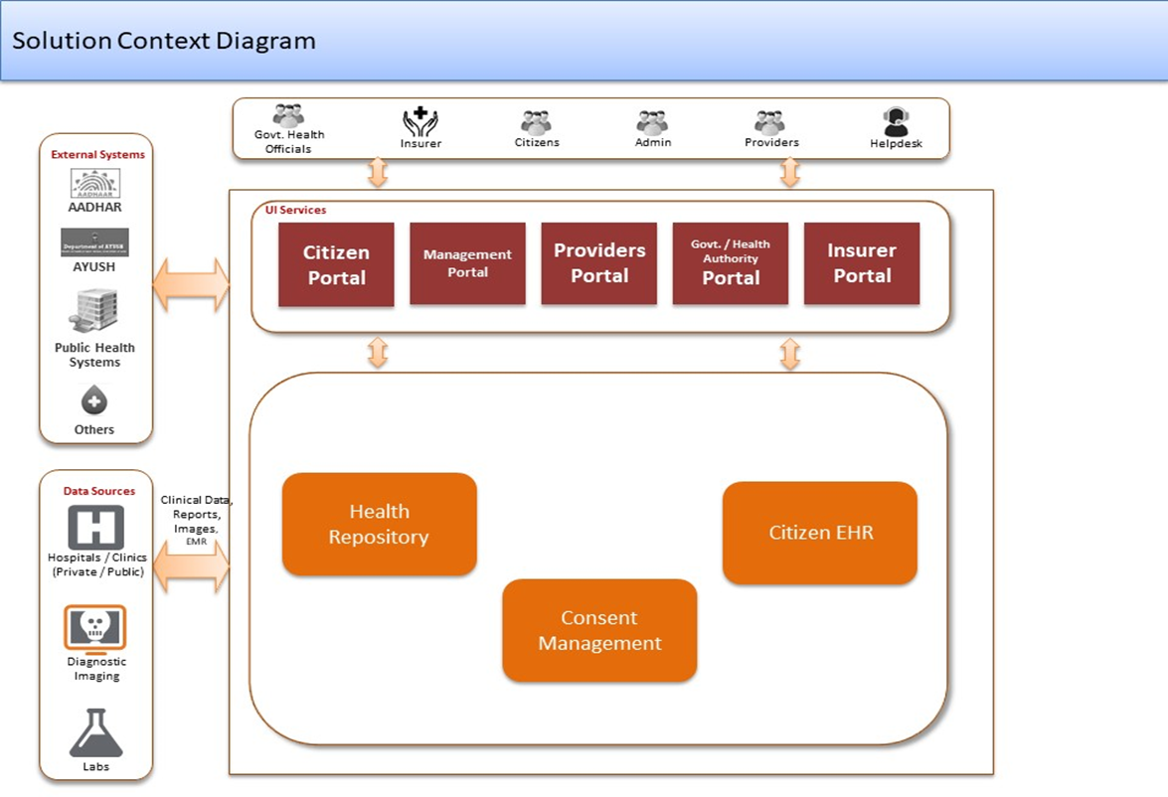
Solution Building Blocks

Slide 6
PADU was created as a decision-making framework to allow us to standardize our applications and underlying technologies
Goal: Identify assets that deliver similar functions or value and standardize on the smallest solution set possible
Business Capabilities
Technology Taxonomy
Our technical environment is structured by two key frameworks – Business Capabilities and Technology Taxonomy – that organize application and technology assets.
Both of those kinds of assets (applications and technologies) are classified by PADU.
PADU over time is a roadmap that describes our preferred destination platforms and our discouraged legacy.
Capabilities have accountable ownership somewhere in the enterprise.
ARBs leverage PADU data for guiding new investments away from Discouraged / Unacceptable Applications and Technologies
Business Domain
(ex. Clinical)
Technology Domain
(ex. Data Management Tech)
Business Capability
(ex. Case Mgmt)
Technology Capability
(ex. Relational DB)
EA defines the structure of Business Capabilities in partnership across the owners in LOBs.
EA defines the structure of Technology Taxonomy in partnership across the owners in EEEPS, EIS, and ATC
Business Solution (App)
(ex. ICUE, Apollo, ECP)
Technology Solution (tech)
(ex. Oracle, MySQL, SQL Server)
Assets
App PADU informed by Tech PADU + Tech PLM
LOB CIOs and Chief Architects define the solutions for a capability and the PADU of things in it – ideally leaning out the Preferred options.
EEPS (mature tech), EIS (security) and ATC (emerging tech) define the solutions for a tech capability and the PADU for things in it.
Assets are the subjects of PADU classification
6

Slide 7
How do we optimize and modernize?
.
MANY
SOME
FEW or ONE
7

Slide 8
The PADU framework reflects a “full stack” approach to standardizing and modernizing our technology environments
To effectively accelerate our modernization journey, we will continue to evolve our PADU framework to be a holistic “whole stack” approach that drives strategic decisions across our portfolios
Management of 6K+ application assets, with added criteria for commercial software
Application PADU
Commercial
PADU
Commercial software has distinct PADU criteria (see appendix)
Management of 2K distinct technology solutions across 20 domains
Technology PADU
Examples of Tech PADU include:
Desktop Software
Application Libraries
Integration Software
Cloud Services (SaaS)
Pattern PADU
Management of 35 distinct hardware solutions
Hardware PADU (appliances + peripherals)
We need to continue to remind our teams that PADU is a means to an end, not the end itself
8

Slide 9

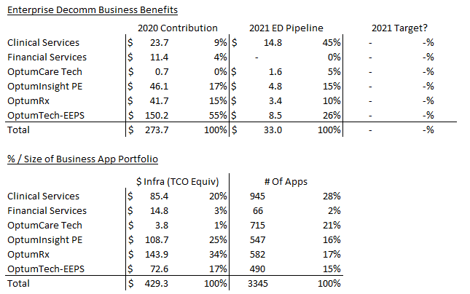
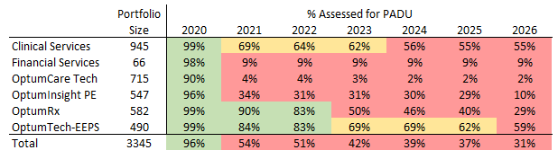
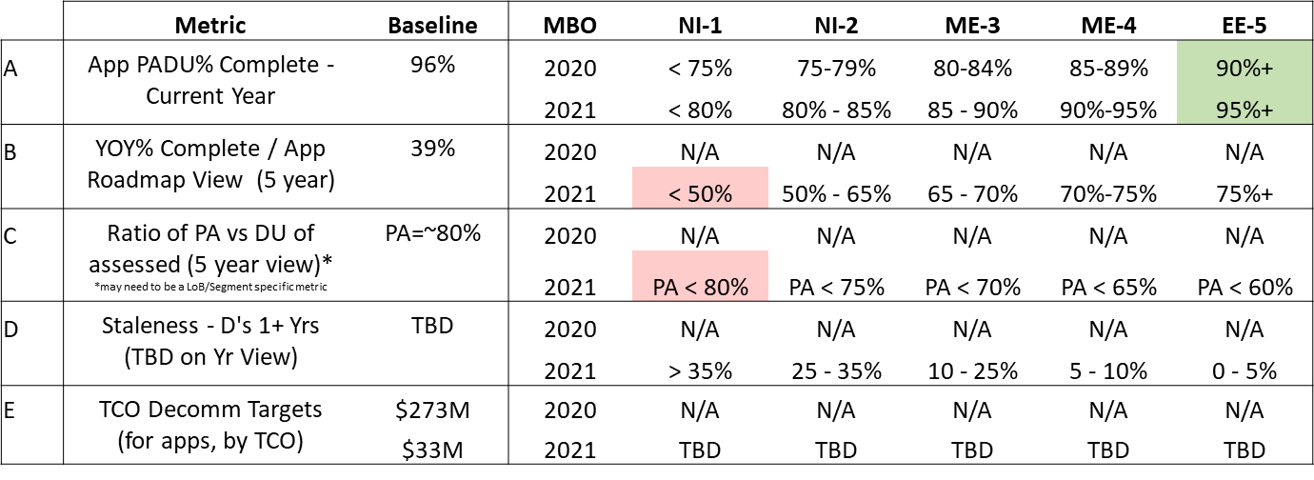
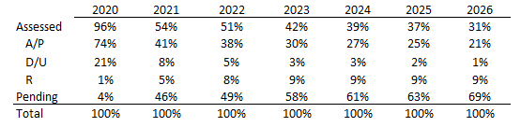
Optum Portfolio – Application Portfolio Management & Decommission Pipeline
Status as of: 12/03/2020
Optum Roadmaps
Optum Decommission Pipeline
Defined Roadmaps
About 40%+ of the portfolio have 3-to-5-year roadmaps defined
Significant progress since July roll out
July
Optum Targets – For Discussion
Portfolio Rationalization Trends
Current state A/P to D/U/R ratios are ~75% / 20%
Desire is to flip the ratio on current portfolio assets in 3-5 year period
Too much of the portfolio is unassessed in future years to validate rationalization goals

Slide 10
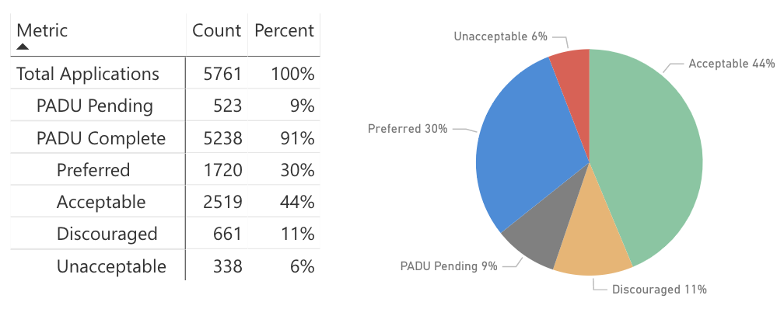
While we have mapped a majority of our application to PADU, we simply have too many classified as “Preferred/Acceptable”
Notes:
Captured Dec 11, 2020

Slide 11
Our approach is also intended to be more aggressive pre and post close when it come to integrating and rationalizing acquired entities
Benefit Multiplier of Acquired Platform Capabilities
Examples: Rally & IHR
Problem Statement: Enterprise value is lost when we do not intentionally include acquired capabilities into our platform ecosystem
Solution: Connect pre and post-acquisition activities by building upon the M&A due-diligence framework created by E&I Architecture team
How
Use pre-close due diligence outputs to drive additional PDAU and decom activities
Expand EA community to include technology leaders of acquired companies
Standardize pre/post acquisition EA framework across LoBs and corporate
Benefit – Shorter time to derive enterprise platform value of acquired technology, reduction of duplicative solutions

Slide 12
We continue to evolve our Technology PADU approach to support our enterprise strategies
Enterprise Technology Strategies:
Advance our technology strategies of increased open source, increased engineer competence, and decreased vendor dependence​
Accelerate project delivery by constraining the available options which limits technology-based uncertainty and constrain proliferation​
Promote cloud-based infrastructure for the virtues of availability/elasticity etc., scaling with utilization​
Decrease spend on non-cap tech and vendors to meet MOVE objectives​
12

Slide 13
Technology Capability / Landscape Overview
Expressing our technology capabilities with OT leadership as owners
IT Service Management
Mike Tesmer
Developer Tools
App Integration
Bob
Peck
Bob Peck
Heather Mickman
Content Management
AI/ML/Geospatial
Melissa
Flicek
Josh Cutler
IT Management
(Finance, Accounting)
Analytics Enablement
Jason
Benson
Heather Mickman
3rd Party SaaS
Security, Identity & Compliance
End User Compute
Data (Mgmt., Migration, DB)
Chad Walker
Jamie Burnett
Frank Orr
Heather Mickman
Operations Management
OmniChannel – Contact Center
John Garner
Craig
Howarth
Compute
Frank Orr (physical, virtual)
Heather Mickman (HCC, PaaS, containers)
Network
Storage
Richard Scott
Allison Miller
Jason Nollinger
Frank Orr

Slide 14
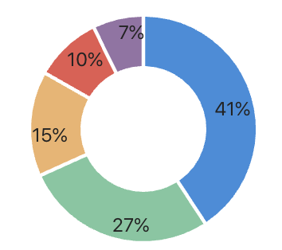
Technology & Enterprise Strategy Alignment via PADU
Goal: Accelerate decision-making by reducing complexity
Enterprise Technology Landscape
1,970 entries - 400 new titles this year
40,000 page views
40 Contributors
REST API & Flowdock ChatBot
Refined capability domains (Data Management, Digital, OmniChannel/Voice, AI, Operations)
License compliance integration via Barista
TechHub integration for IT Product offerings
Desktop software PADU transitioned to AppStore
Rally Health tech inventory additions
1970
Notes:
Source: http://techlandscape-visualization.optum.com/

Slide 15
Technology & Enterprise Strategy Alignment via PADU
Goal: Accelerate decision-making by reducing complexity
7000 total software titles in AppStore
3500+ PADU assignments
Capability Domain alignment to Tech Landscape
Workgroup Representative e-mail distribution lists
Procurement & BSL engagement
Search, Sort and Filter in new AppStore (Q1’21)
47% P, A
1200+ Discouraged titles – old or little-used
Notes:
Source: http://techlandscape-visualization.optum.com/

Slide 16
Technology PADU Outcomes, Challenges, and Opportunities
Accelerate decision-making by reducing complexity
Outcomes
Challenges
Opportunities
Reuse of enterprise assets
Influence to software procurement
Expense avoidance
Appstore inventory reduction
Maturing tech strategy
Increased visibility into R&D efforts, acquired entity tech portfolio
Disengaged IT capability owners
Immature IT Product strategies
Fragmented application catalogs
Weak restriction policies
Obscure cost and recovery data
IT Capability roadmaps
Auto-discovery of software components
App-Tech-PADU mapping
Web site search and maintenance improvements
Automated governance through AppStore
Categorical cost reporting

Slide 17
Roadmapping Outcomes, Challenges, and Opportunities
Drive application rationalization across the enterprise
Outcomes
Challenges
Opportunities
Baseline of IT App Portfolio
99% of 495 applications have PADU
91% Preferred or Acceptable
Baselining of IT Product Portfolio
74% of 977 IT Infrastructure products have PADU
79% of mapped are Preferred or Acceptable
28% unmapped
35 Unacceptable app/tech remediated
Poor PADU understanding
Unclear IT Product roadmap
No IT Product Capability Model
IT Products tied tightly to vendor products
Unclear replacements for U tech
No app team budget for PLM
Chargeback disincentives
Weak exception process
Active IT Product Management
Annual PADU attestation and roadmap
Targeted annual PA vs DU ratios
cost, lic mgt, recovery, forced app PLM
Formal decommissioning timeframes
12-18mo for U, 18-24mo for D
IT Product capability model
Chargeback disincentives
Strong exception process
HALF of all CBAs (52 of 104) depend upon at least one of 21 U technologies

Slide 18
Capability Level Spend Reporting

Slide 19
Capability Level Spend Reporting
Driving towards strategic investments
Outcomes
Challenges
Opportunities
Very first expense/capability domain report
Product-level expense reporting (validated with pilot groups)
Mapping of Procurement categories to Tech Taxonomy
Strategic partnership with ES&P, IT Finance
Unaligned product taxonomies
Cross-domain vendors
Vague or broad purchase orders
Multi-year contracts
“Uncategorized” spend through Insight
No traceability to IT or Business Application
Product-level spend data
Reseller spend data
Tighter taxonomy alignment
Traceability back to consuming IT or business app
Tougher exception process
Cost reduction MBOs

Slide 20
Enterprise Application Insights
Drive application rationalization across the enterprise
Business PADU - LoB assessment of Application fulfillment of a specific Business Capability
Tech PADU - aggregated value of application software alignment to enterprise technology strategies¹
Engineering Standards - system alignment and adoption of architecture and engineering best practices, including HCC, HCP²
Hardware PADU - hardware alignment to enterprise technology strategies³
API First!

Slide 21
Critical Business Applications with PADU-U Tech Dependencies
52 of 104 CBAs dependent upon at least one of 21 U technologies
ESB - ESERVICES BILLING
OCIS
CPW - CLAIMS PROCESSING WORKSTATION
ICES CLEARINGHOUSE
DATA WAREHOUSE (UHC CS)
EDI-B2B
EMPLOYER ESERVICES PORTAL
MYUHC
ACIS - AUTOMATED CASE IMPLEMENTATION SYSTEM
BEHAVIORAL HEALTH BENEFITS AND ELIGIBILITY
CDB - CONSUMER DATABASE SYSTEM
CLAIMS HIGHWAY
COSMOS - COMPREHENSIVE ONLINE SOFTWARE FOR MANAGEMENT AND OPERATIONAL SUPPORT
EEMS - ELECTRONIC ELIGIBILITY MANAGEMENT SYSTEM
LINX
LIVE AND WORK WELL (LAWW)
OPTUM PAY
PROVIDER EXPRESS
SRPS
UHC RETIREE PORTAL
UNET TOPS
FACETS (OHBS)
BAAG - INTRANET BENEFITS AT A GLANCE
IISET - INTEGRATED SERVICE EXPERIENCE TOOL
FACETS (CS CSP)
NICE - NEWLY INTEGRATED COMPUTER ENVIRONMENT
PAYMENT ENGINE
INDIVIDUAL MASTER DATA MANAGEMENT
HYPERION FINANCIAL REPORTS
RXCLAIM WEB SERVICES
COMPREHENSIVE POLICY ADMINISTRATION SYSTEM
ICARE
ICUE - INTEGRATED CLINICAL USER EXPERIENCE
LEAN - LANDMARK ELECTRONIC APPLICATION NAVIGATOR
OPTUMID
OPTUMRX MEMBER MOBILE
PAS - PRIOR AUTHORIZATION SYSTEM
DOCUMENTUM (UHC ENTERPRISE DOCUMENT MANAGEMENT SYSTEM ECAA)
HEALTH4ME
IRIS - INTEGRATED RX INFORMATION SYSTEM
ACCENT
CLAIM PAYMENT SYSTEM (UMR)
QFINITI ENTERPRISE
RXWEB
TASK TRACKER
UNITED ESERVICES PORTAL
CES - CONSOLIDATED ELIGIBILITY SYSTEM
ELGS - ENTERPRISE LETTER GENERATION SYSTEM
NDB - NETWORK DATABASE
PRIME
TREASURY CHECK DATA
VCC DESKTOP
Notes:
Data as of Sept 17, 2020, Credit: Phil Coppock
These were identified using the following data sources and method:
- The 104 CBAs from ASK reports
- The Enterprise Software PADU list from the Tech360 PLM Dashboard (removing Unacceptable java, ruby, and visual studio hits in order to focus on more enterprise assets)
- Cross-reference of these based on CBA Name
- Filtering on Unacceptable tech entries to determine unique apps and PADU-U Tech
- Updated PADU-TBD where possible and filtered for PADU-U
- Removed any entries with 0 servers associated to tech
Determined unique Apps and Tech

Slide 22
Critical Business Applications with PADU-U Tech Dependencies
21 Identified U technologies
AIX 5.3
AIX 6.1
AIX 7.1 TL4
AIX 7.1 TL5
AIX 7.2 TL3
DataStage11.3
DB2UDB10.5
DB2UDB11.1
DB2UDB9.7
IBM HTTPServer6.1
IBM HTTPServer8.5
Oracle 10g Release 1
RedHat Enterprise Linux 5.11
RedHat Enterprise Linux 5.6
Solaris10
Solaris11
WeblogicServer10.3
Windows 2003 R2 SP2
Windows 2003 SP2
Windows 2008 R2 SP2
Windows 2012
Notes:
Data as of Sept 17, 2020, Credit: Phil Coppock

